Slide 1
Essentials of Adobe Experience Design
@chrisgriffith

Slide 2


Slide 3
So many tools…

Slide 4
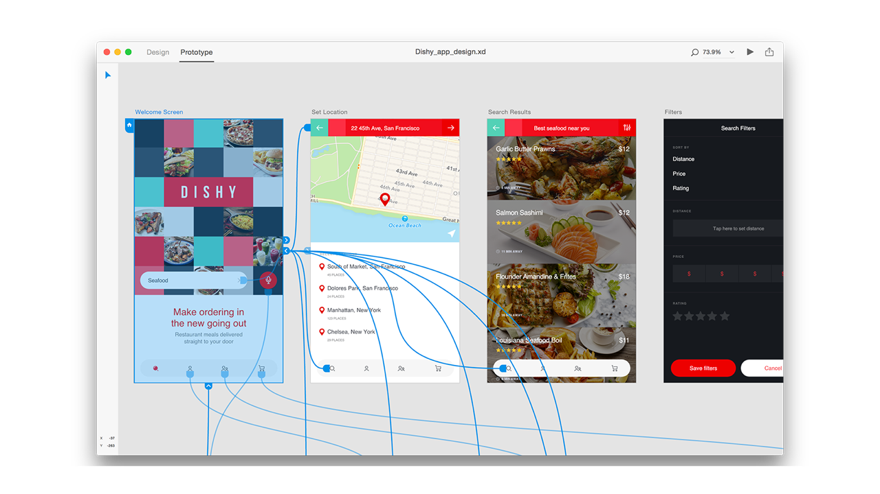
Adobe XD

Slide 5
Adobe XD
OCT
2015
MAR
2016
DEC
2016
OCT
2017
v 0.5
Mac
v 0.6.8
Windows 10
http://www.adobe.com/products/experience-design/features.html

Slide 6
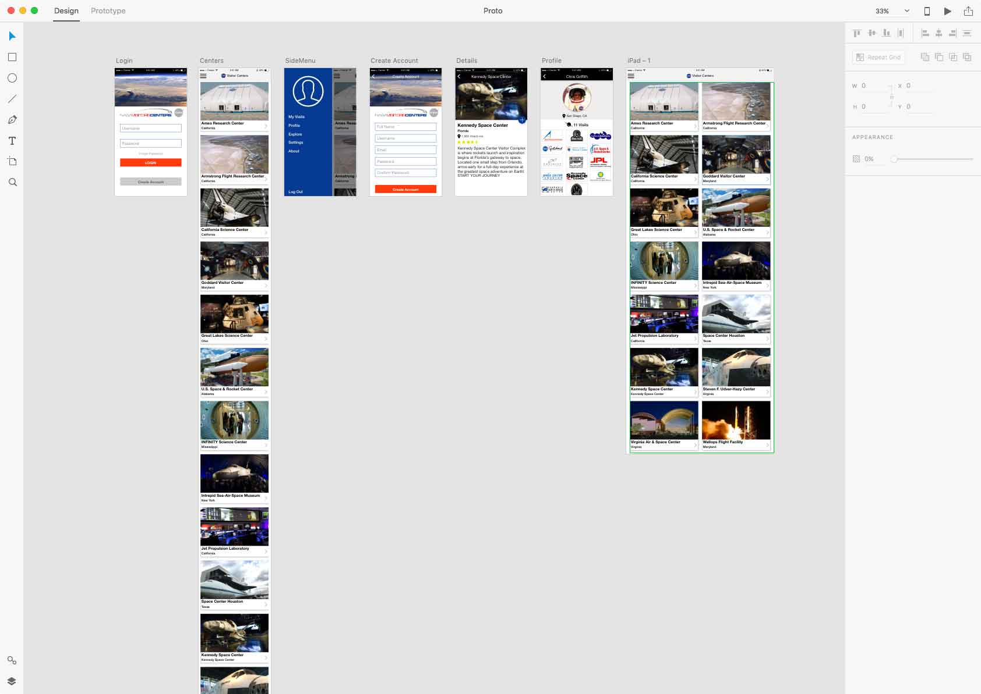
Demo

Slide 7
Topics
What is XD and what does it do
Review of the interface
Overview of Design & Prototype
Working with XD Artboards
Choosing and using an artboards
Rearranging, renaming and deleting
Working with Content
Overview of graphic formats
Adding content to XD
Adding and formatting text
Using shapes and masks
Creating and editing layouts with Repeat Grid
UI Kits
Creating Interactive Prototypes
Overview of the Prototype Mode
How to link artboards and content to each other
Testing, Sharing and Exporting
Using project previews
Sharing XD projects Exporting XD content
What's next

Slide 8
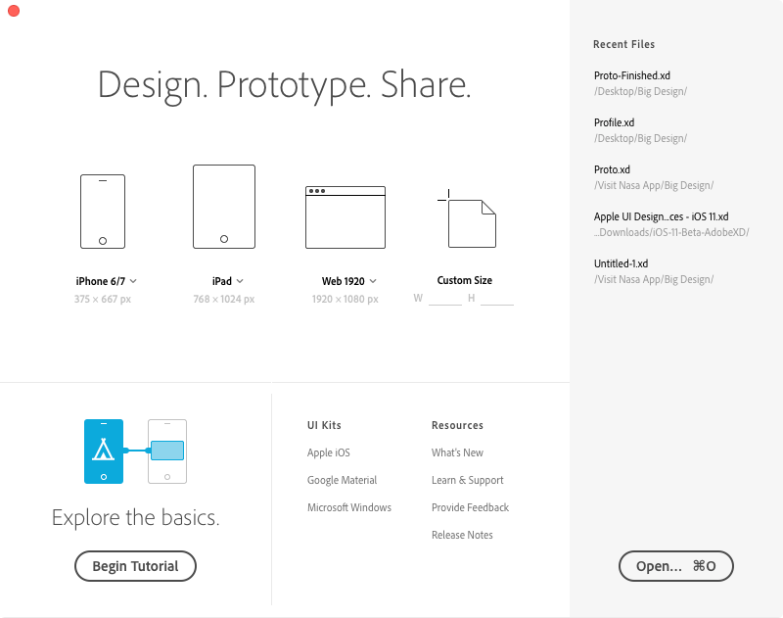

Slide 9
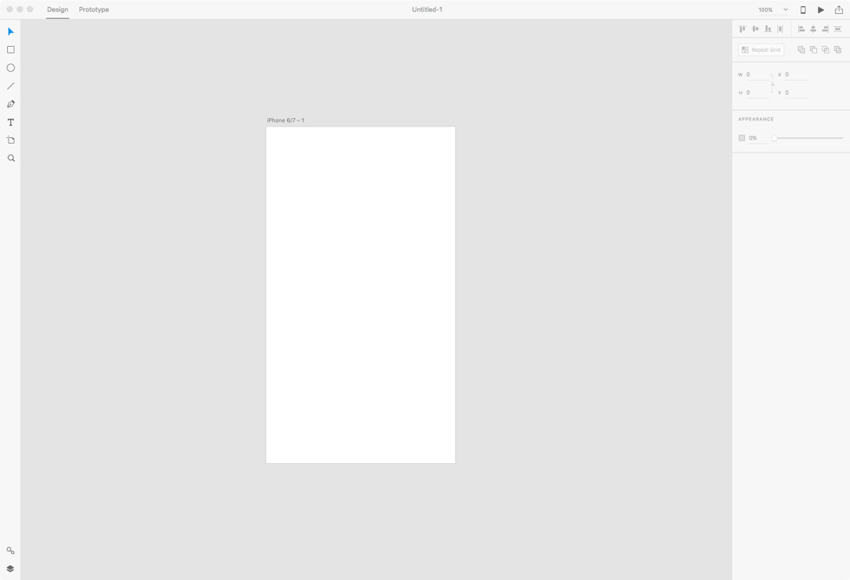

Slide 10
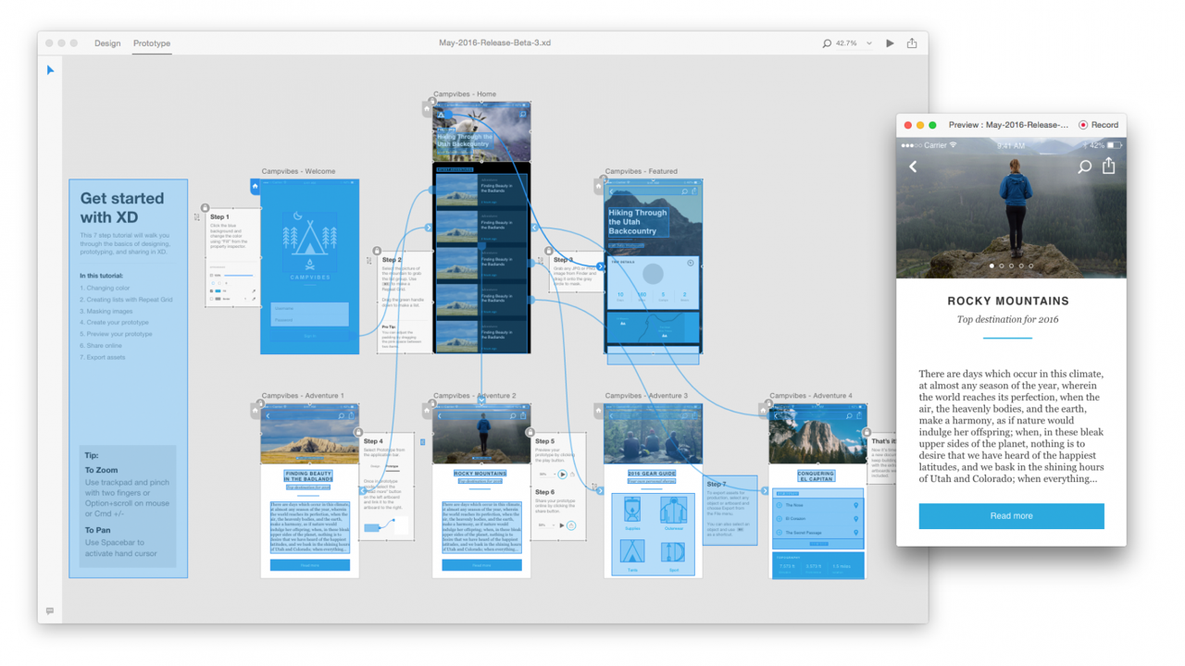

Slide 11
What’s Next?
Subject to change…

Slide 12
UserVoice
https://adobexd.uservoice.com/

Slide 13


